Slide 1
SOFTWARE REENGINEERING
1

Slide 2
Contents
Introduction
What is program slicing?
Principle of dependences
Variants of program slicing
Slicing classifications
Applications of program slicing
Program slicing matrices
Program slicing tools
Current and future challenges
References

Slide 3
Introduction [1/3]
The size and complexity of a software gets harder to understand, maintain and test
You might have had questions like
If I change this statement, what pieces of the program are going to be affected?
Where are the values that flow into this statement coming from?
How can I limit the functionality to only what I need?

Slide 4
Introduction [2/3]
Goals
Debug your thousands lines of code easily by reducing the complexity of the program
Write a robust program before testing your code
Save your testing time by limiting the tests to only those that exercise the changed code

Slide 5
Introduction [3/3]
How ?
“Break larger code into smaller pieces”
Unlike most other methods, slicing is applied to programs after they are written, and is therefore useful in maintenance rather than design

Slide 6
What is program slicing?
[1/3]
Program slice is a decomposition technique that extracts statements relevant to a particular computation from a program
Program slicing describes a mechanism which allows the automatic generation of a slice

Slide 7
What is program slicing?
[2/3]
Slicing criterion <s , v>
Where s specifies a statement/location (statement s) and v specifies a variable (v)
All statements affecting or affected by the variables mentioned in the slicing criterion becomes a part of the slice

Slide 8
Principle of dependences
Data dependence
Definition of variable v at statement s1 reaches a use of v at statement s2
Control dependence
Conditional statement controls whether or not the current statement is executed

Slide 9
Example of program slicing
Original program:
begin
read(x,y)
total := 0.0
4 sum := 0.0
5 if x <= 1
Slice criterion:
<9, x>
begin read(x,y) end.
Slice criterion:
<12, total> begin read(x,y) total := 0 if x <= 1
then
else total := x*y end.
Slice criterion:
<12, z>
begin read(x,y)
if x<=1
then
else read(z) end.
6
7
8
9
10
then sum := y else begin
read(z) total := x*y end
write(total, sum)
end.
Notes:
Write (total)
Writw (sum)

Slide 10
Variants of program slicing
Static slice
Dynamic slice
Conditioned slice

Slide 11
Variants of program slicing
Static slices [1/3]
Slice criterion <p, V>
Where p is a program point and V is a subset of program variables
Program slice on the slicing criterion <p, V> is a subset of program statements that preserves the behavior of the original program at the program point p with respect to the program variables in V

Slide 12
Variants of program slicing
Static slices [2/3]
Slices derived from the source code for all possible input values
No assumptions about input values
May lead to relatively big slices
Contains all statements that may affect a variable for every possible execution
Current static methods can only compute approximations

Slide 13
Variants of program slicing
Static slices [3/3]
Intermediate representation of programs for slicing
Control Flow Graph (CFG)
Data Flow equations are solved
Program Dependence Graph (PDG)
Slice is computed as graph reachability problem

Slide 14
Recall: control flow graph (CFG)
Each program statement is a node
A directed edge will connect between any 2 nodes that represent statements with a possible control flow between them
Special nodes: start, stop
Definitions
–
–
–
: directed path from I to j
: set of nodes that are influenced by i
: all of the variables that are defined (modified) at statement i
: all of the variables that are referenced (used) at statement i
–

Slide 15
Recall: program dependence graphs (PDG)
Each node represents a statement (like CFG)
Directed edges represent
Control dependence (bold lines) – between a predicate and the statements it controls
Data dependence (Regular Lines) – between statements modifying a variable and those that may reference it
Special “entry” node is connected to all nodes that are not control dependant

Slide 16
Static slices example
Slice criterion (12,i)
1 main( )
2 {
3 int i;
3.3 int sum;
4 sum = 0;
5 i = 1;
6 while(i <= 10)
7 {
8 sum = sum + 1;
9 ++ i;
10 }
11 Cout<< sum;
12 Cout<< i;

Slide 17
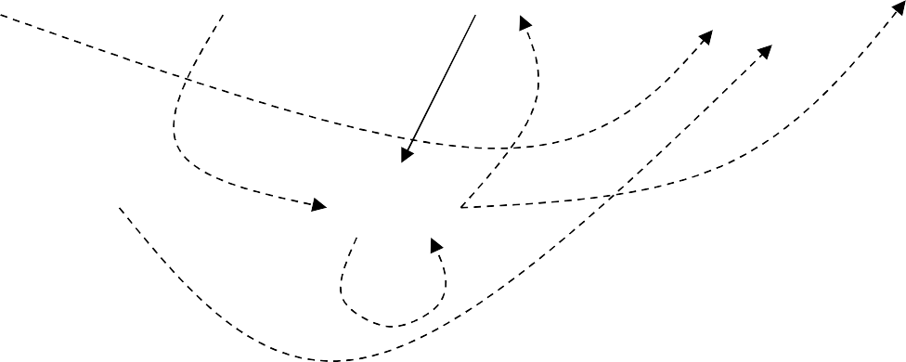
PDG of previous static slice example
Control Dep. Edge Data Dep. Edge
1
3
4
5
6
11
12
Slice Point
8
9

Slide 18
Variants of program slicing
Dynamic slices
Dynamic slice preserve the meaning of the variable in the slicing criterion for a single input to the program
Slicing criterion: <i, p, v>
Where I is input, p is program point and v is program variable
Deterministic instead of probabilistic
Allow an easier localization of the bugs
Another advantage of dynamic slicing is the run-time handling of arrays and pointer variables

Slide 19
Example of dynamic slices
read (n)
for I := 1 to n do 3. a := 2
if c1==1 then
if c2==1 then
6. a := 4
7. else
8. a := 6
z := a
write (z)
Assumptions
Input n is 1
C1, c2 both true
Execution history is
1¹, 2¹, 3¹, 4¹, 5¹, 6¹,
9¹, 2², 10¹
Slice criterion<1, 10¹, z>

Slide 20
Variants of program slicing
Conditioned Slices
Conditioned slicing can be viewed as filling the gap between static and dynamic slicing
Conditioned slice preserves the semantics of the slicing criterion only for those inputs that satisfy a boolean condition

Slide 21
Example of conditioned slice
1. read(a) 2. if (a < 0)
3. a = -a 4. x = 1/a
5. Write x
Assumptions
Input ‘a’ is positive number

Slide 22
Slicing classifications
Levels of slices
Intraprocedural slicing
Interprocedural slicing
Direction of slicing
Backward
Forward

Slide 23
Slicing classifications
Levels of slices
Intraprocedural slicing
Computes slice within one procedure
Assumes worse case for function calls
Interprocedural slicing
Compute slice over an entire program
Two ways for crossing procedure boundary
Up: going from sliced procedure into calling procedure
Down: going from sliced procedure into called procedure
Must be context sensitive

Slide 24
Slicing classifications
Direction of slicing
Backward slicing
Backward slice of a program with respect to a program point p and set of program variables V consists of all statements and predicates in the program that may affect the value of variables in V at p
Answer the question “what program components might effect a selected computation?”
Preserve the meaning of the variable (s) in the slicing criterion for all possible inputs to the program
Useful in debugging

Slide 25
Example of backward slicing
Slice criterion <12,i>
1 main( )
2 {
3 int i, sum;
4 sum = 0;
5 i = 1;
6 while(i <= 10)
7 {
8 Sum = sum + 1;
9 ++ i;
10 }
11 Cout<< sum;
12 Cout<< i;

Slide 26
Slicing classifications
Direction of slicing
Forward slicing
Forward slice of a program with respect to a program point p and set of program variables V consists of all statements and predicates in the program that may be affected by the value of variables in V at p
Answers the question “what program components might be effected by a selected computation?”
Useful in determining which all statements in a program can be effected by change in value of v at statement Si

Slide 27
Example of forward static slicing
Slice criterion <3,sum>
1 main( )
2 {
3 int i,
3.3 int sum;
4 sum = 0;
5 i = 1;
6 while(i <= 10)
7 {
8 sum = sum + 1;
9 ++ i;
10 }
11 Cout<< sum;
12 Cout<< i;

Slide 28
Applications of program slices [1/2]
Program debugging
Was introduced by Mark Weiser as debugging aid
Slicing visualizes control and data dependencies
It highlights statements influencing the slice
Testing: reduce cost of regression testing after modifications (only run those tests that needed)
Integration : merging two programs A and B that both resulted from modifications to BASE

Slide 29
Applications of program slices [2/2]
Program understanding
Reverse engineering: comprehending the design by abstracting out of the source code design decisions
Software maintenance: changing source code without unwanted side effects
Software quality assurance: validate interactions between safety-critical components

Slide 30
Program slicing matrices
Set of metrics proposed by Weiser in 1981
Coverage
Overlap
Clustering
Parallelism
Tightness

Slide 31
Program slicing tools
CodeSurfer
Commercial product by GammaTech Inc.
GUI Based
Scripting language-Tk
Unravel
Static program slicer developed at NIST
Slices ANSI C programs
Limitations are in the treatment of Unions, Forks and pointers to functions

Slide 32
Current and future challenges
Current challenges
Implementation
Size: reducing the size of a slice
Future challenges
Increasing dynamic nature of languages
Slicing will become more specialized
Beyond slicing programs
Fundamental program building blocks

Slide 33
References
M. Weiser., Program Slicing, Proc. of the Fifth International Conference on Software Engineering, pages 439-449, May 1981
D. Binkley, K. Gallagher., Program Slicing, Proc. of In Advances in Computers, Volume 43, 1996.
A. DeLucia., Program Slicing: Methods and Applications, IEEE workshop on Source Code Analysis and Manipulation (SCAM 2001)

Slide 34
Question & Answer
37
Thanks for your attention!

